Slide 1
Node.js and MongoDB work
By Saifullah

Slide 2
Web scrape using MySQL, Node.js, Discord API and VBScript
This project was done to see the capability of VBScript and how well it would work with Node.js and Discord API.
VBScript is use to scrape the contents of interest and insert them in to a table in MySQL. Node.JS would only access the database if a certain command is used in Discord. Then output it. Code and pictures are shown on next slide.

Slide 3
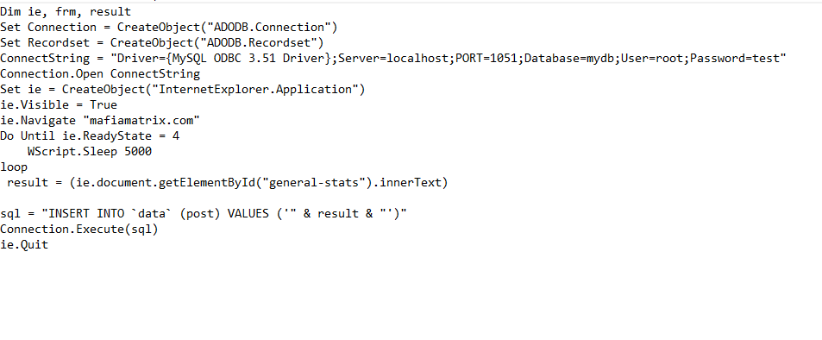
Code

Slide 4
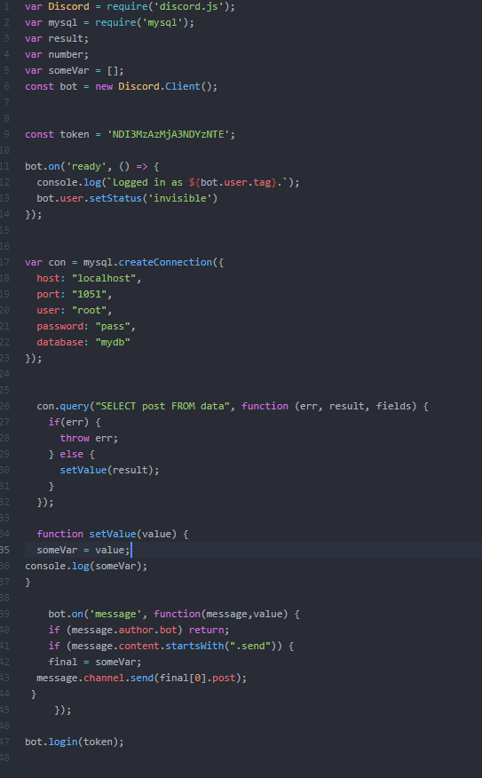
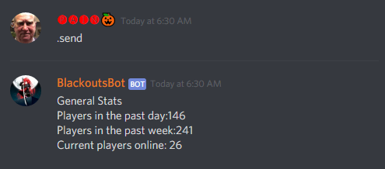
Code

Slide 5
Front-end clone experiment using Node.js, Express and Puppeteer
This work is in progress currently, to see whether it is possible to clone a websites functionality without database access.
The idea is to have users control a website of mine and behind every feature of my website has Puppeteer taking the data and using it on another website. The result of that would be extracted and sent over to the user.

Slide 6
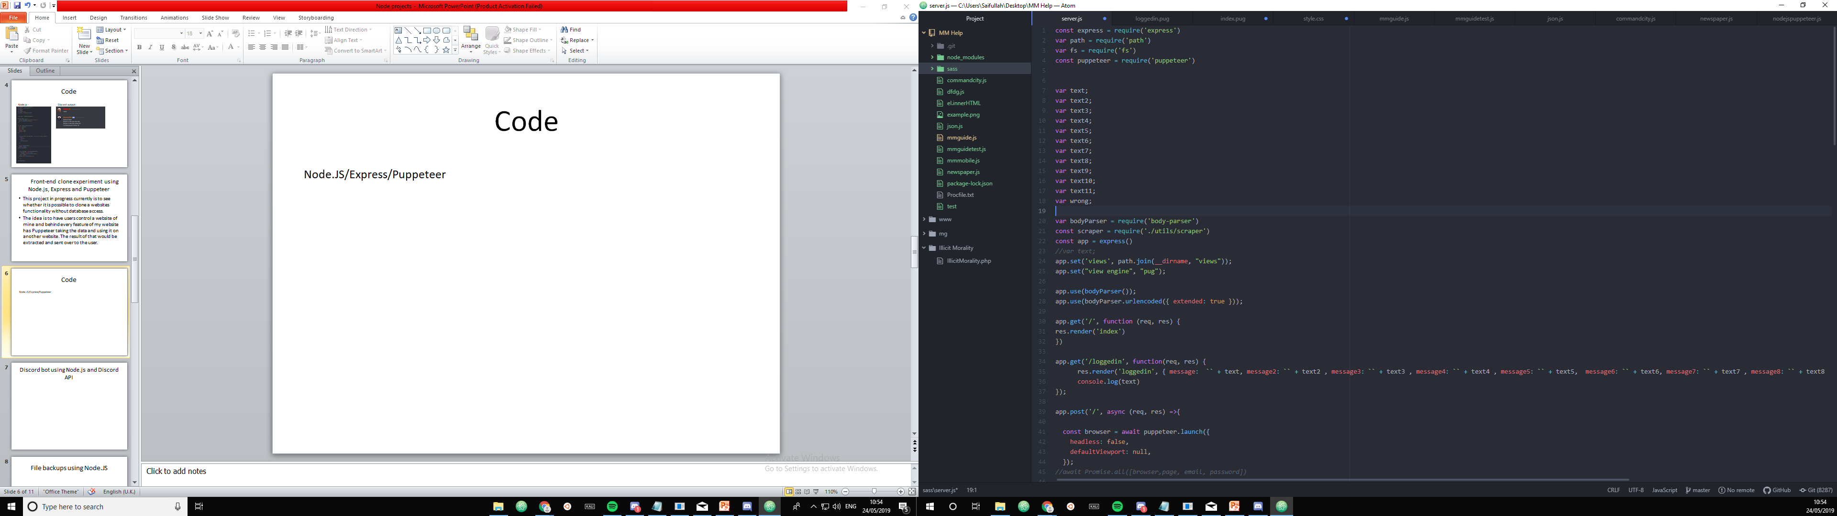
Code

Slide 7
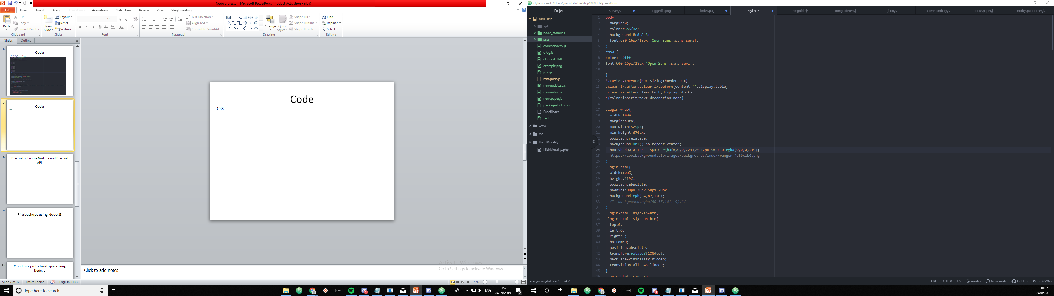
Code
CSS -

Slide 8
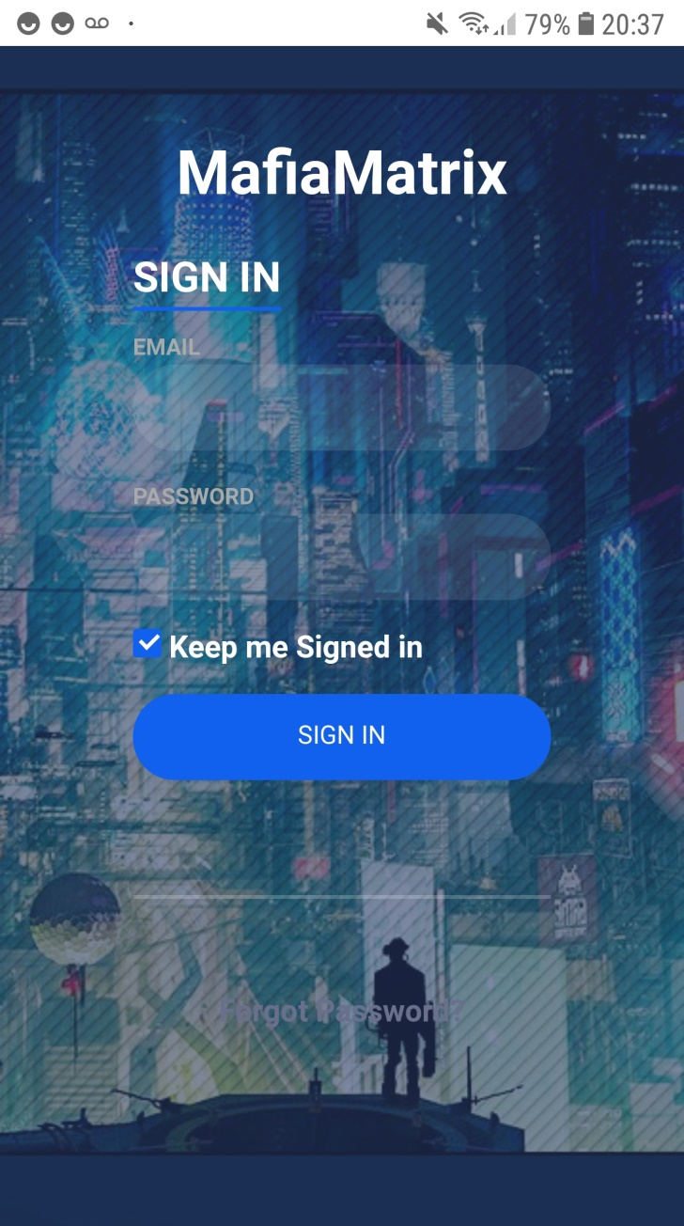
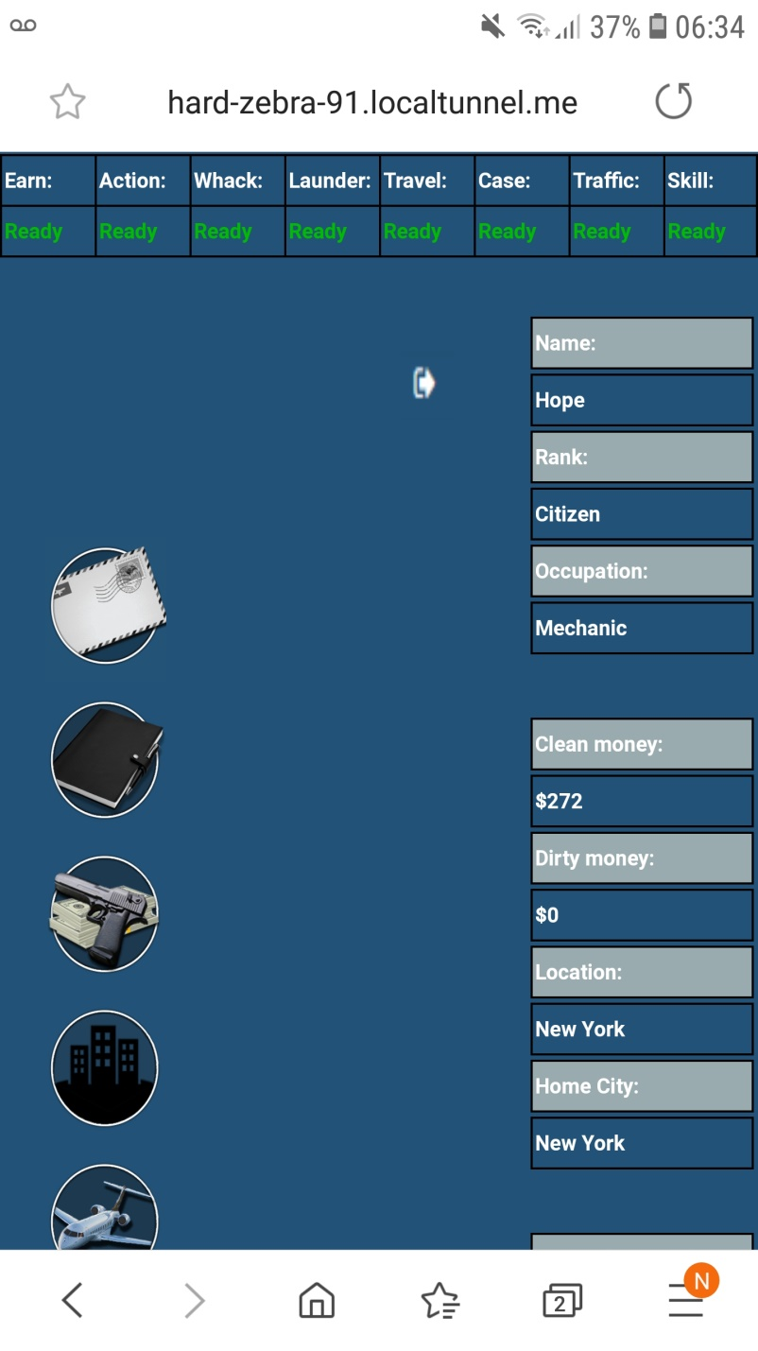
Pictures

Slide 9
Discord bot using Node.js and Discord API
This project is a guiding system to help players in discord that play a game.
Users write a command in discord and then get a reply.

Slide 10
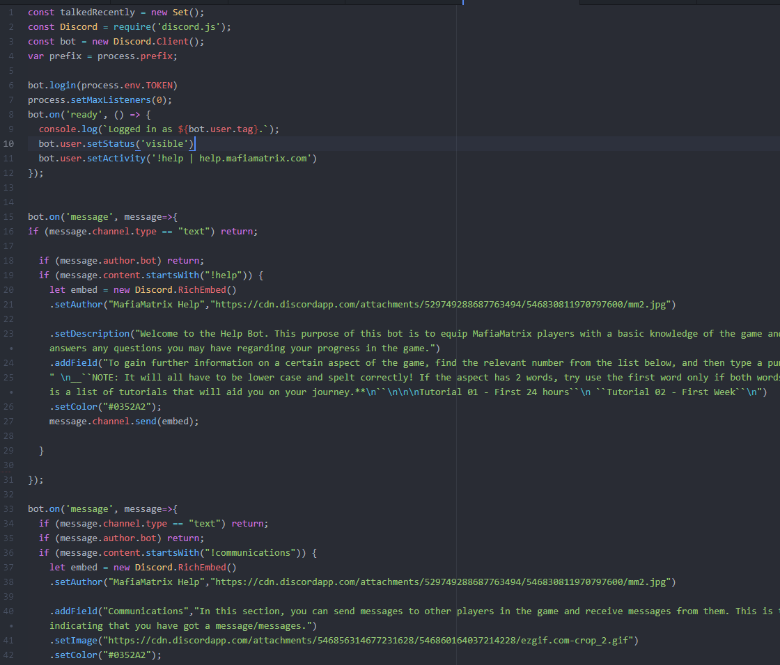
Code

Slide 11
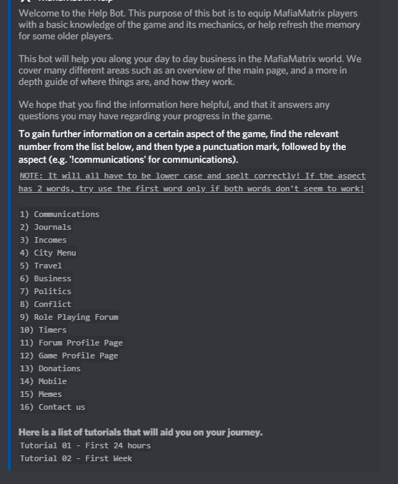
Picture

Slide 12
Database backups using Node.JS
This project is currently being used to make backups of MySQL database. At first it was used done every 30 minutes but was removed later.

Slide 13
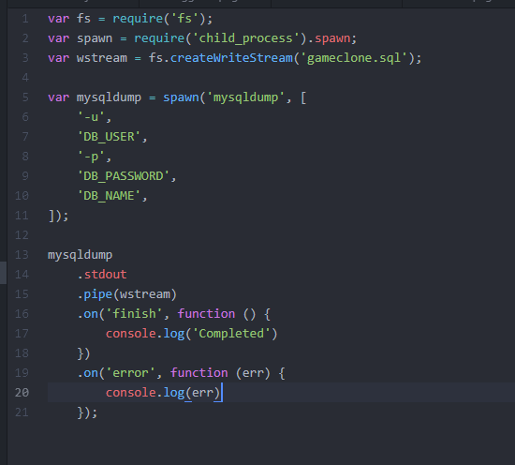
Code

Slide 14
Cloudflare protection bypass using Node.js
This project was done to bypass the Cloudflare protection pop up. When it comes to scraping content from a website without being IP whitelisted from the site. You get the Cloudflare and usually you will have to place a delay in the code.
What if the system that you are implementing requires constant data update without any delays of the site?
Best approach is to develop a separate script that handles with extracting the cf_clearance cookie in the browser and store in a file/database. In my case I just used on the main as it restarts every hour. The cf_clearance cookie expires every hour and 30 minutes. Whether its like that for all sites or not is not something I know.

Slide 15
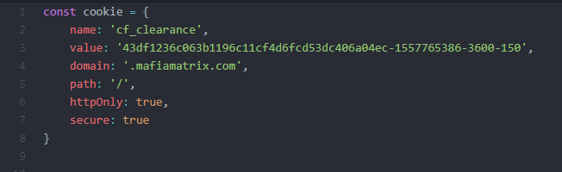
Code

Slide 16
JSON manipulation and extraction using Node.js and Puppeteer
This project uses Puppeteer and goes on JSON site and extracts required content.

Slide 17
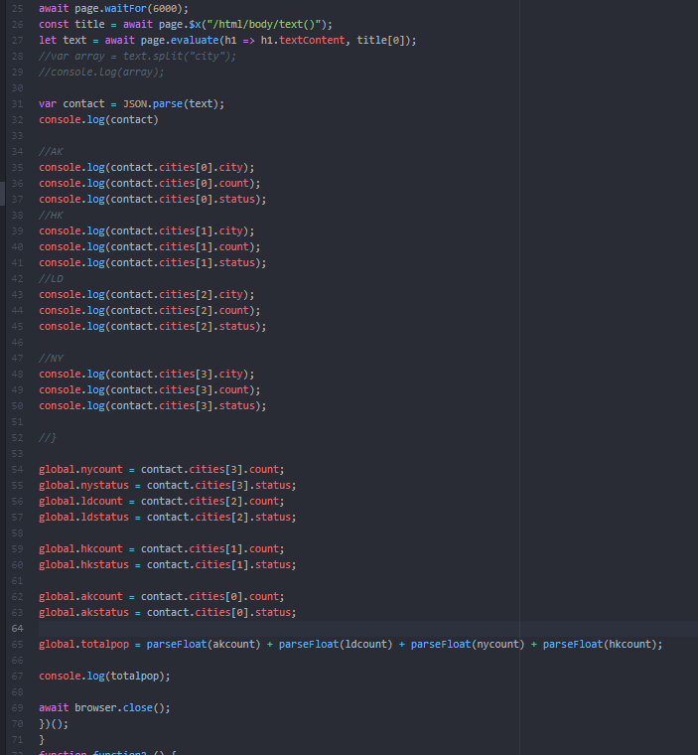
Code

Slide 18
MongoDB and Node.js
This project shows list of users that are registered on the database. Along with their IDs.
To do this one needs to create a cursor to iterate through the different records in the database.

Slide 19
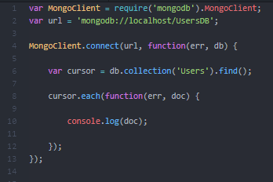
Code

